Slide 1
HAL’S UPDATE AND OUTLOOK
TDG LLF2.1
JULY 12, 2012

Slide 2
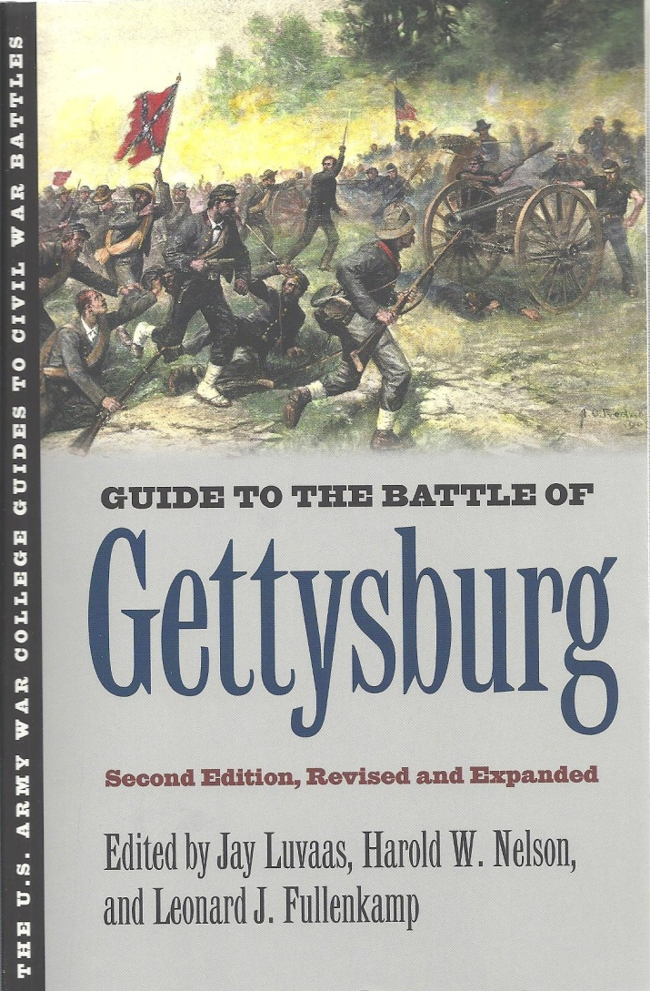
NEW EDITION OF GETTYSBURG GUIDE FINALLY COMPLETE!

Slide 3
CLOSE-IN TARGETS
CHICAGO WITH DICK IN JULY
War College Case Study on Transformational change in the Army—August
Normandy with retired Generals and Admirals in late August
Normandy with Corporate Leaders in Sept.
CANTIGNY WITH DICK IN OCTOBER
Gettysburg, Cold Harbor, Ft. Donelson, Antietam

Slide 4
Learning Resources at Cantigny Leadership Legacy Forum
Dick Dooley plus great speakers
The First Infantry Division Museum
Cantigny Mansion and Grounds
Col. (U.S. Army, Retired) Paul Herbert, PhD
Participants

Slide 5
The Essence of the “Staff Ride”
Approach to studying leaders
“To study leadership is to study what others have to say and then to study ourselves.”
Robert Terry, Authentic Leadership (1993)
On the battlefield we get to study what others do as well as what they say, but then we still need to study ourselves.

Slide 6
Basic Approach to Leadership Learning
On the “Staff Ride”
1. The settings have enormous power
2. Preparatory materials are appealing
3. All learning capabilities [senses] are used
4. Leader decisions—and consequences-- are clear
5. Leader energies and interactions are addressed
6. Emphasis on learning: What does it mean?

Slide 7
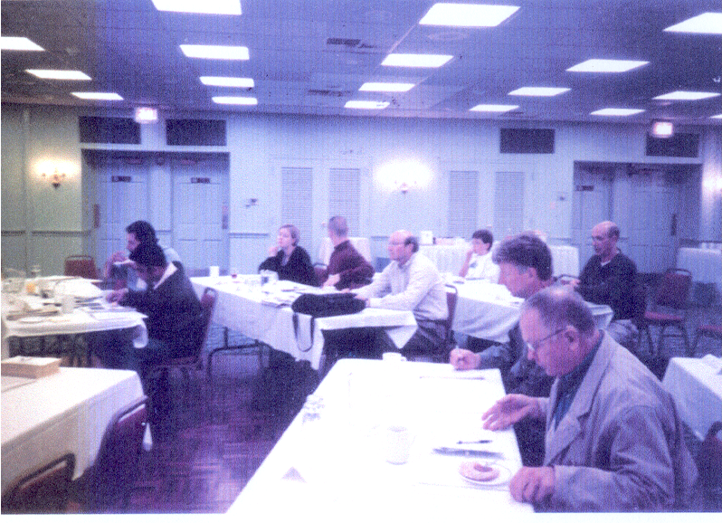
Seminars and traditional classroom work
Improve dialog about leader challenges
Historians can discuss topics ranging beyond the battlefield
Other experts can introduce new material
Everyone can share their efforts to apply what they learn

Slide 8
What Makes a Good Leader?
Adapts quickly to new situations
Keeps cool under pressure
Clearly explains missions, standards, priorities
Sees the big picture; gives context
Can handle “bad news”
Gets out to visit the troops
Sets a high ethical tone
Knows how to delegate
Makes tough, sound decisions on time
Builds and supports teamwork
Is positive, encouraging, and reasonably optimistic

Slide 9
THE MODERNIZATION STRATEGY
(1994)
Win the Information War
Project and Sustain Combat Power
Protect the Force
Execute Precision Strikes
Dominate Maneuver

